Slide 1
EEG-Based Emotion Detection Using Roberts Similarity
and PSO Feature Selection
Presented By
T. DEEPTHI REDDY (22BFA05395)
D. SIVA KARTHIK (22BFA05349)
S. A. SADIYA THASNEEM (22BFA05374)
S. T. VINAY (22BFA05378)
Under The Guidance of
B. Vijaya,
Assistant Professor
Department of Computer Science And Engineering
S V COLLEGE OF ENGINEERING
(Autonomous)
Karakambadi Road, Opp. LIC Training Center
Tirupati-517507

Slide 2
OUTLINE
Abstract
Keywords
Objective
Scope
Existing System
Drawbacks
Proposed System
Modules
UML Diagrams
Software & Hardware Requirements
Project Implementation
Output Screens
Literature Survey
References

Slide 3
ABSTRACT
Emotion detection using electroencephalography (EEG) signals is applied in areas such as mental health, human-computer interaction, and affective computing. This framework processes EEG data using both machine learning and deep learning techniques. Important features are extracted using the Extra Trees Classifier and further optimized with the PSO Feature Model Selector, where K-Nearest Neighbors (KNN), Support Vector Machine (SVM), and Random Forest are used to improve feature selection and classification performance. For emotion classification, hybrid deep learning models such as CNN-LSTM are used to capture spatial and temporal patterns, along with Roberts Similarity to measure EEG pattern similarity. Deep Convolution Network is also utilized to learn hierarchical features directly from raw EEG signals. The proposed approach improves accuracy, robustness, and real-time processing, enabling the development of personalized and empathetic emotion-aware systems for healthcare and advanced human-machine interaction.

Slide 4
KEYWORDS
EEG , Emotion Detection , Extra Trees Classifier , Feature Extraction , PSO Feature Model Selector , KNN , SVM , Random Forest , CNN-LSTM , Roberts Similarity , DeepConvNet, Machine Learning , Deep Learning , Signal Processing, Affective Computing , Human-Computer Interaction , Mental Health , Real-time Processing.

Slide 5
OBJECTIVE
The objective of this project is to develop an advanced EEG-based emotion detection system using a combination of feature extraction techniques, machine learning, and deep learning models. By employing the Extra Trees Classifier for efficient feature extraction, the project aims to optimize the feature selection process through the PSO Feature Model Selector, incorporating KNN, SVM, and Random Forest. Additionally, the system integrates a CNN-LSTM hybrid model and Roberta Similarity to capture spatial and temporal dependencies in EEG signals, enhancing emotion recognition. This project seeks to improve emotion classification accuracy, robustness, and real-time processing, contributing to applications in healthcare and human-computer interaction.

Slide 6
SCOPE
The scope of this project focuses on developing a robust EEG-based emotion detection system that integrates advanced feature extraction, selection, and classification techniques. The system will utilize the Extra Trees Classifier for feature extraction, the PSO Feature Model Selector for optimizing feature selection with KNN, SVM, and Random Forest, and a hybrid CNN-LSTM model for emotion classification. The project will also incorporate Roberta Similarity to enhance emotion recognition accuracy by evaluating EEG signal patterns. The primary goal is to improve emotion detection accuracy, efficiency, and real-time processing, making the system suitable for applications in healthcare, human-computer interaction, and mental health monitoring. Future work may extend the system to real time emotion detection in various environments, including wearable EEG devices and interactive systems.

Slide 7
EXISTING SYSTEM
Existing EEG-based emotion detection systems mainly depend on traditional machine learning algorithms such as Support Vector Machine (SVM), K-Nearest Neighbors (KNN), and Random Forest. These approaches require manual extraction of statistical features from EEG signals, including frequency bands and power spectral values. Since EEG data is complex and highly noisy, these models struggle to identify meaningful emotional patterns accurately.
Most traditional methods analyze EEG signals as static data and fail to capture temporal changes in brain activity over time. Emotional states vary continuously, and conventional classifiers cannot effectively learn these sequential dependencies. As a result, the performance of these systems becomes inconsistent across different users and conditions.
Due to high dimensionality and noise in EEG signals, existing systems often show lower accuracy and poor real-time capability. They require significant preprocessing and still cannot generalize well for practical healthcare or human-computer interaction applications.

Slide 8
DRAWBACKS
1. Data & Signal Issues
EEG signals are noisy due to body movements and external disturbances.
High-dimensional data increases processing time and complexity.
2. Feature Extraction Limitations
Manual feature extraction may miss important emotional information.
Static features cannot capture changes in brain activity over time.
3. Model Performance Issues
Traditional models cannot capture spatial and temporal patterns effectively.
Low accuracy for different users and emotional variations.
4. Real-Time & Practical Challenges
Requires heavy preprocessing, making real-time detection difficult.
Hard to implement in real-world applications.

Slide 9
PROPOSED SYSTEM
The proposed system improves EEG-based emotion detection by combining advanced feature extraction, selection, and classification methods. Important features are extracted from EEG signals using the Extra Trees Classifier to reduce noise and data complexity. The best features are then selected using the PSO Feature Model Selector with KNN, SVM, and Random Forest to improve accuracy. For emotion classification, a hybrid CNN-LSTM model is used to capture both spatial and temporal patterns in the EEG data, along with Roberta Similarity to compare signal patterns. DeepConvNet is also used to learn hierarchical features directly from raw EEG signals. The system is designed for real-time emotion detection and is suitable for applications in healthcare, human-computer interaction, and mental health monitoring, providing improved accuracy and reliable performance compared to existing systems.

Slide 10
ADVANTAGES
High Classification Accuracy: Uses Extra Trees for feature extraction and PSO for optimized selection, ensuring only the most relevant features improve emotion recognition.
Optimized Feature Selection: PSO with KNN, SVM, and Random Forest handles high-dimensional EEG data efficiently, reducing redundancy.
Real-Time Processing: Supports instant emotion detection for healthcare monitoring and human-computer interaction.
Hybrid Deep Learning: CNN + LSTM captures spatial and temporal EEG features, boosting accuracy and robustness.
Enhanced Generalization: Advanced models like Roberta Similarity and DeepConvNet ensure consistent performance across users and conditions.
Scalability & Flexibility: Modular design enables integration into wearables, mobile devices, and edge computing.

Slide 11
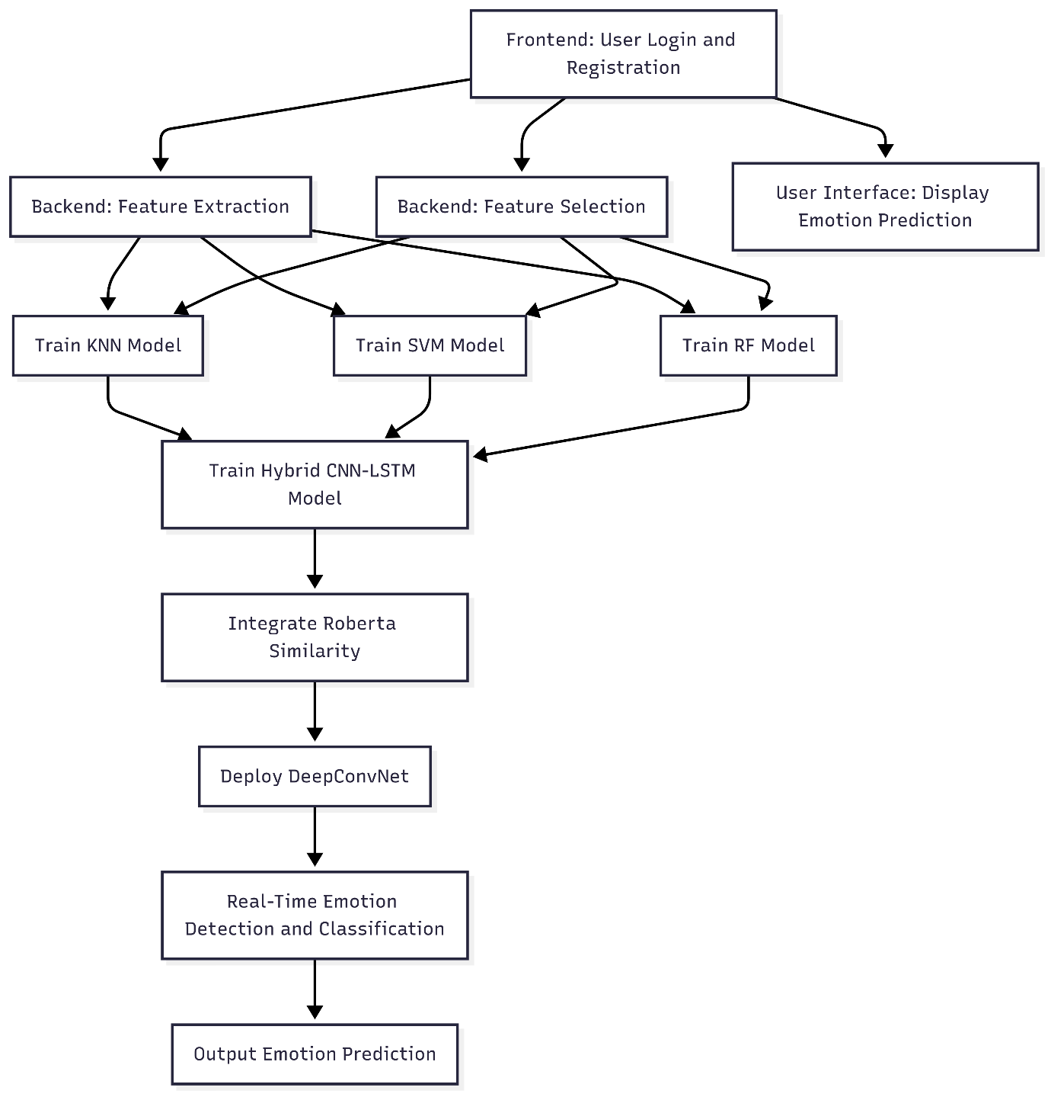
ARCHITECTURE

Slide 12
MODULES
Module 1: Data Collection
Dataset: EEG Brainwave Dataset – Feeling Emotions (Kaggle)
Data collected from 2 participants (1 Male, 1 Female) using a Muse EEG headset
Emotional states recorded:
  Positive – 708 samples
  Negative – 708 samples
  Neutral – 716 samples
Total samples: 2,132
Each emotion recorded for 3 minutes
EEG signals recorded from 4 channels: TP9, AF7, AF8, TP10
Signals resampled to 150 Hz

Slide 13
MODULES
Module 2: Data Preprocessing
Removal of noise and unwanted variations
Min-Max normalization applied to scale values between 0 and 1
Ensures uniform data and improves model performance
Module 3: Feature Extraction
Extra Trees Classifier (ETC) used to extract important features
Extracted features include:
  Time-domain features
  Frequency-domain features
  Non-linear features
Feature importance scores used to identify relevant EEG patterns
Module 4: Dimensionality Reduction
Features ranked based on importance
Irrelevant and redundant features removed
Reduces complexity and improves training speed

Slide 14
MODULES
Module 5: Feature Optimization and Model Training
PSO (Particle Swarm Optimization) selects the optimal feature subset
Feature selection evaluated using:
  KNN
  SVM
  Random Forest
Dataset split into 80% training and 20% testing
Module 6: Deep Learning and Emotion Classification
Deep Convolution Network extracts deep hierarchical features from EEG signals
CNN-LSTM model used for classification:
  CNN captures spatial patterns
  LSTM captures temporal information

Slide 15
MODULES
Module 7: Similarity Analysis and Final Prediction
EEG signals divided into blocks
Roberts Similarity used to compare signal patterns
Majority voting applied for final decision
Output emotion:
  Positive
  Negative
  Neutral
Module 8: Performance Evaluation
Model performance measured using:
  Accuracy
  Precision
  Recall
  F1-Score
  Confusion Matrix

Slide 16
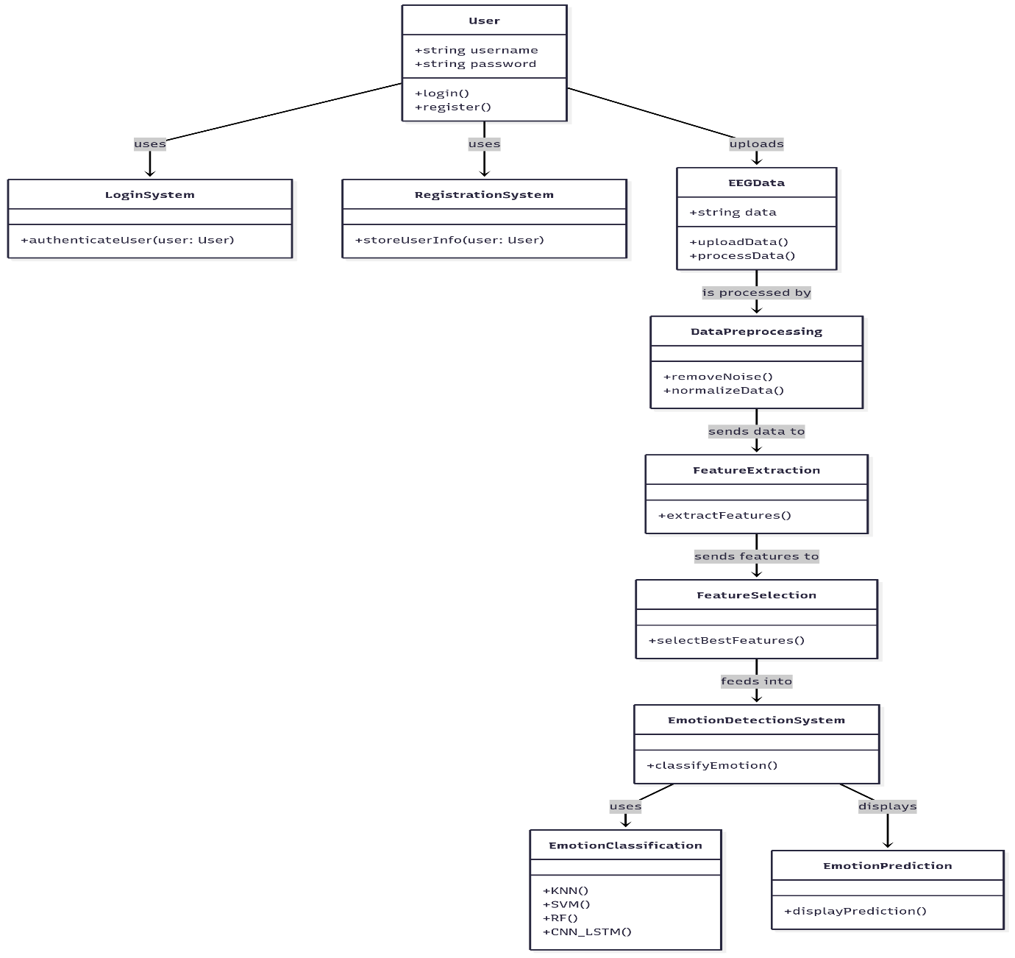
UML DIAGRAMS
Class Diagram:

Slide 17
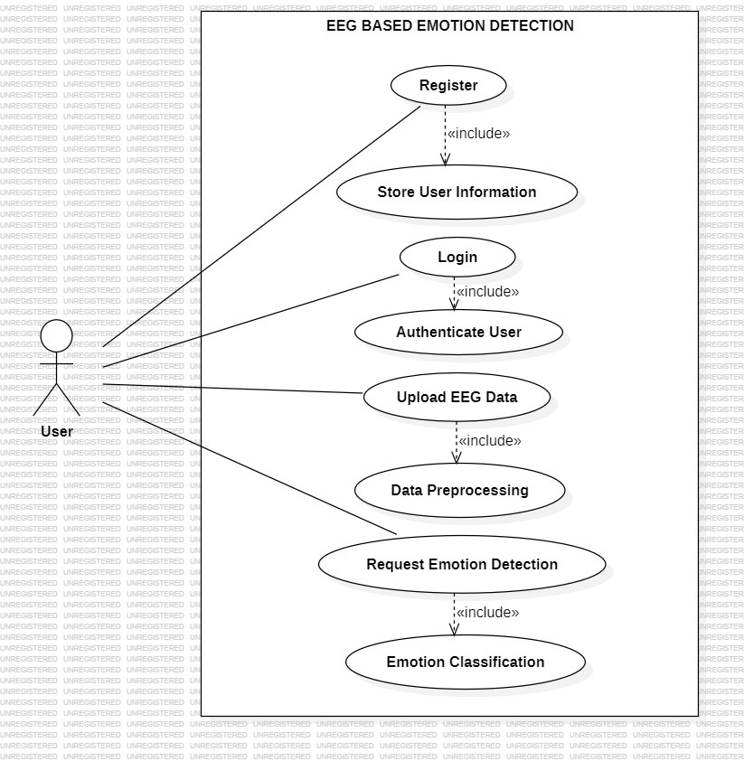
UML DIAGRAMS
Use Case Diagram:
A use case diagram in the Unified Modeling Language (UML) is a type of behavioral diagram defined by and created from a Use-case analysis. Its purpose is to present a graphical overview of the functionality provided by a systemin terms of actors, their goals(represented as use cases), and any dependencies between those use cases. The main purpose of a use case diagram is to show functions are performed for which actor. Roles of the actors in the system can be depicted.

Slide 18
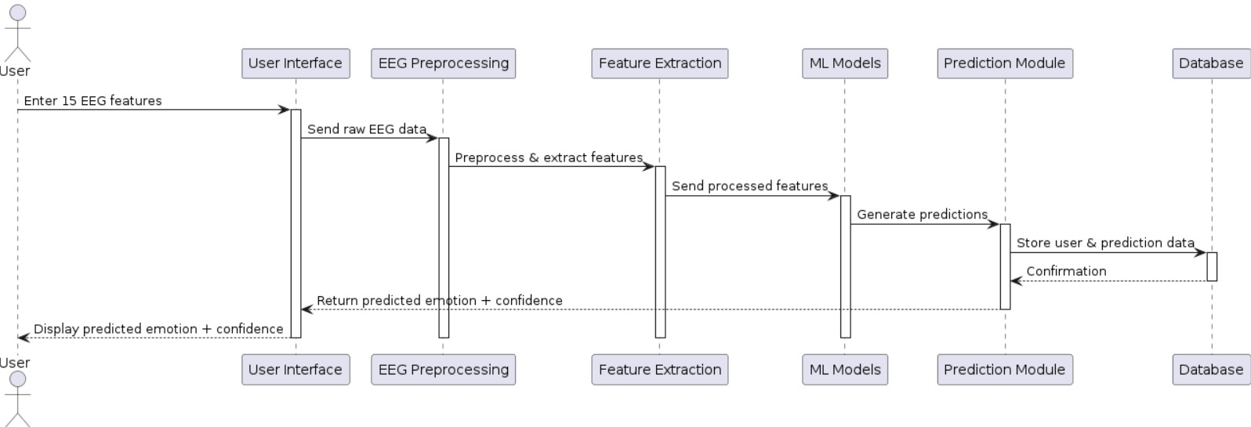
UML DIAGRAMS
Sequence Diagram:
A sequence diagram in Unified Modeling Language (UML) is a kind of interaction diagram that shows how processes operate with one another and in what order.

Slide 19
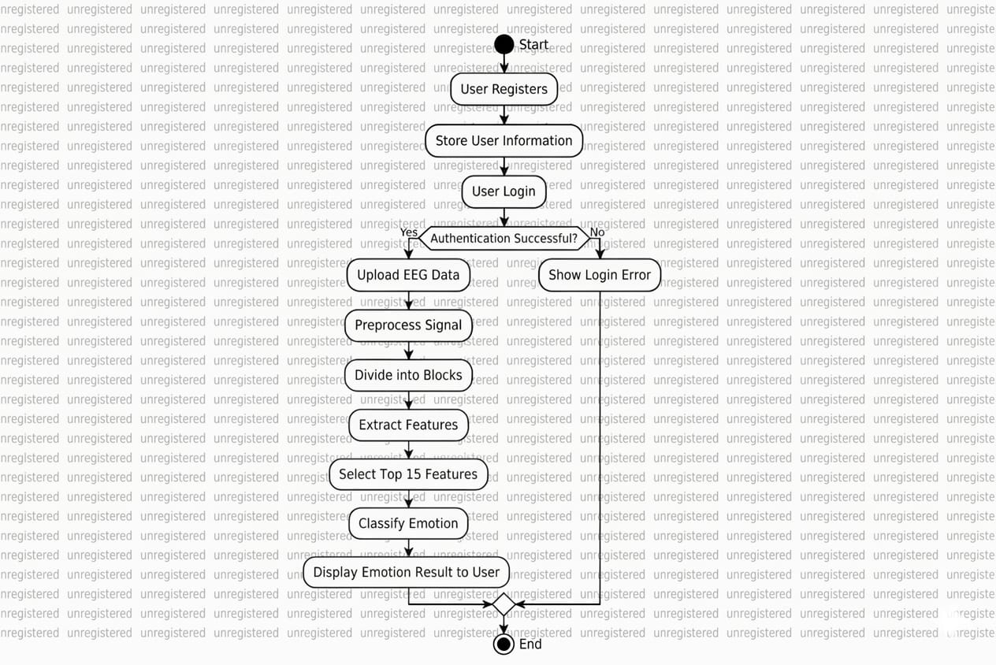
UML DIAGRAMS
Activity Diagram: Shows the step-by-step workflow of activities and the overall flow of control in a system, including decisions and parallel processes.

Slide 20
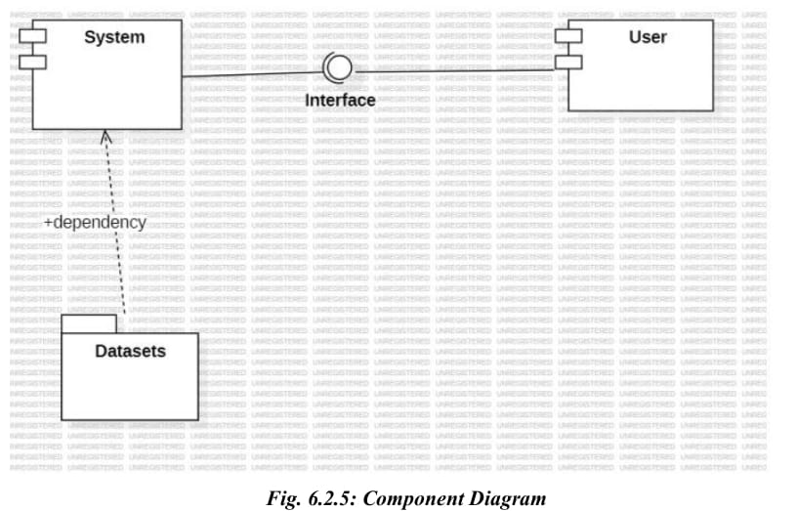
UML DIAGRAMS
Component diagram: A component diagram is a type of UML structural diagram used to model the physical aspects of a system. It breaks down a complex system into smaller, manageable components. Each component represents a modular part of the system, such as a software module, library, or executable, that can be independently developed and later integrated into the complete system.

Slide 21
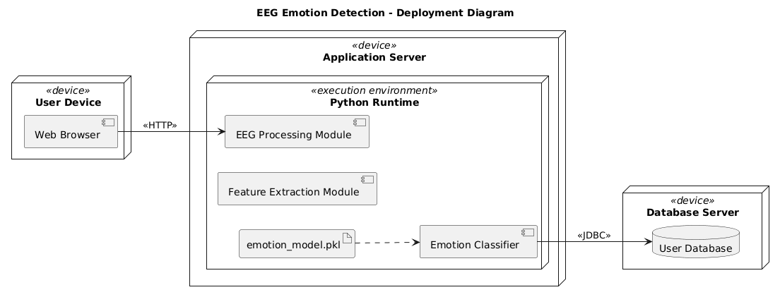
UML DIAGRAMS
Deployment Diagram: Shows the physical hardware (nodes) and how software components are deployed on them in a system.

Slide 22
SOFTWARE AND HARDWARE
SOFTWARE REQUIREMENTS:
Operating System : Windows 7/8/10
Server side Script : HTML, CSS, Bootstrap & JS
Programming Language : Python
Libraries: Flask, Pandas, Torch, Sklearn , Numpy , Seaborn, Matplotlib
IDE/Workbench : VSCode
Server Deployment : Xampp Server
Database : MySQL
HARDWARE REQUIREMENTS:
Processor - I3/Intel Processor
RAM - 8GB (min)
Hard Disk - 128 GB
Key Board - Standard Windows Keyboard
Mouse - Two or Three Button Mouse
Monitor - Any

Slide 23
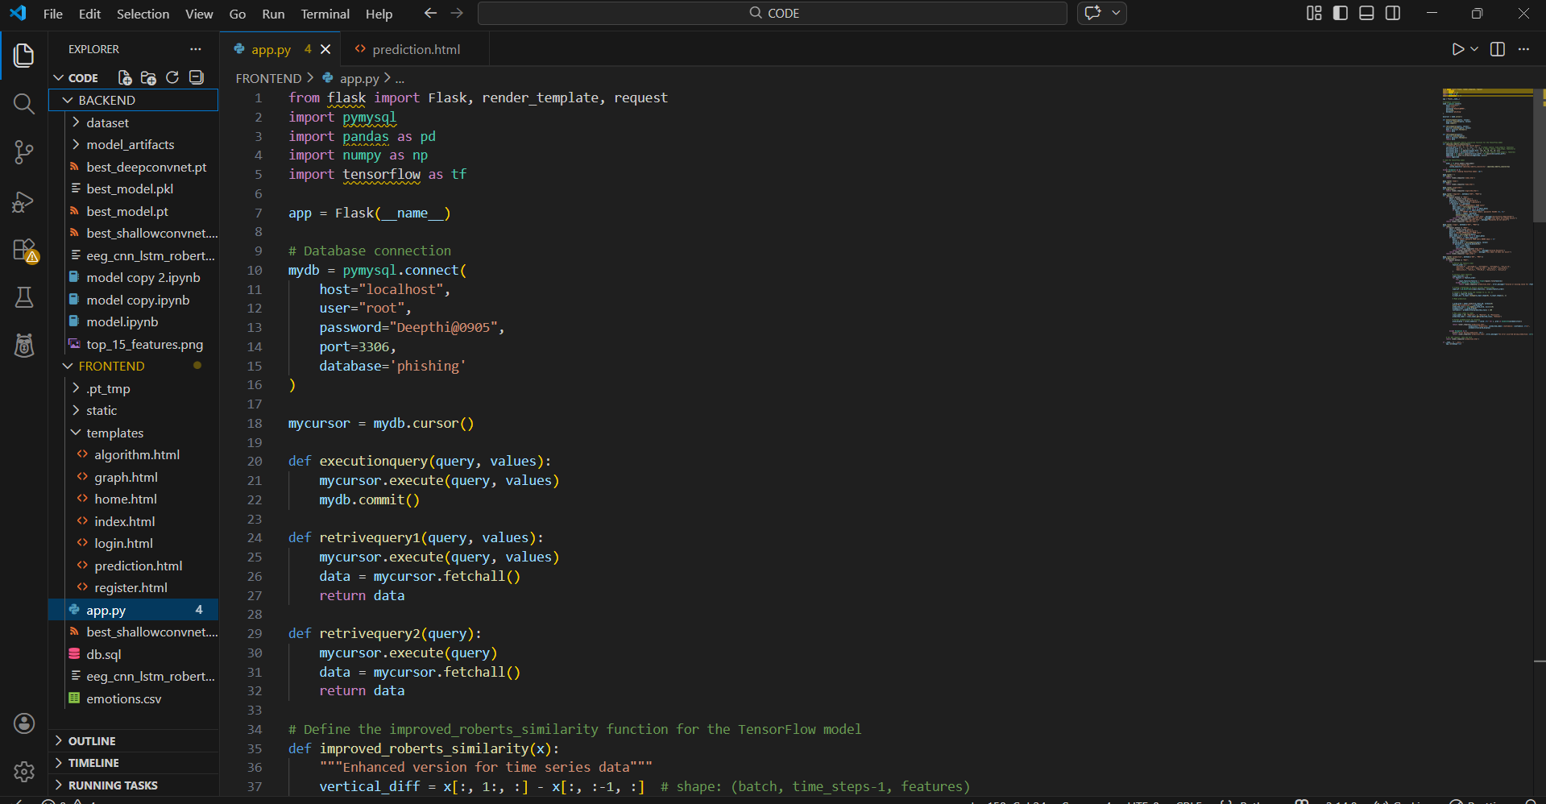
PROJECT IMPLEMENTATION

Slide 24
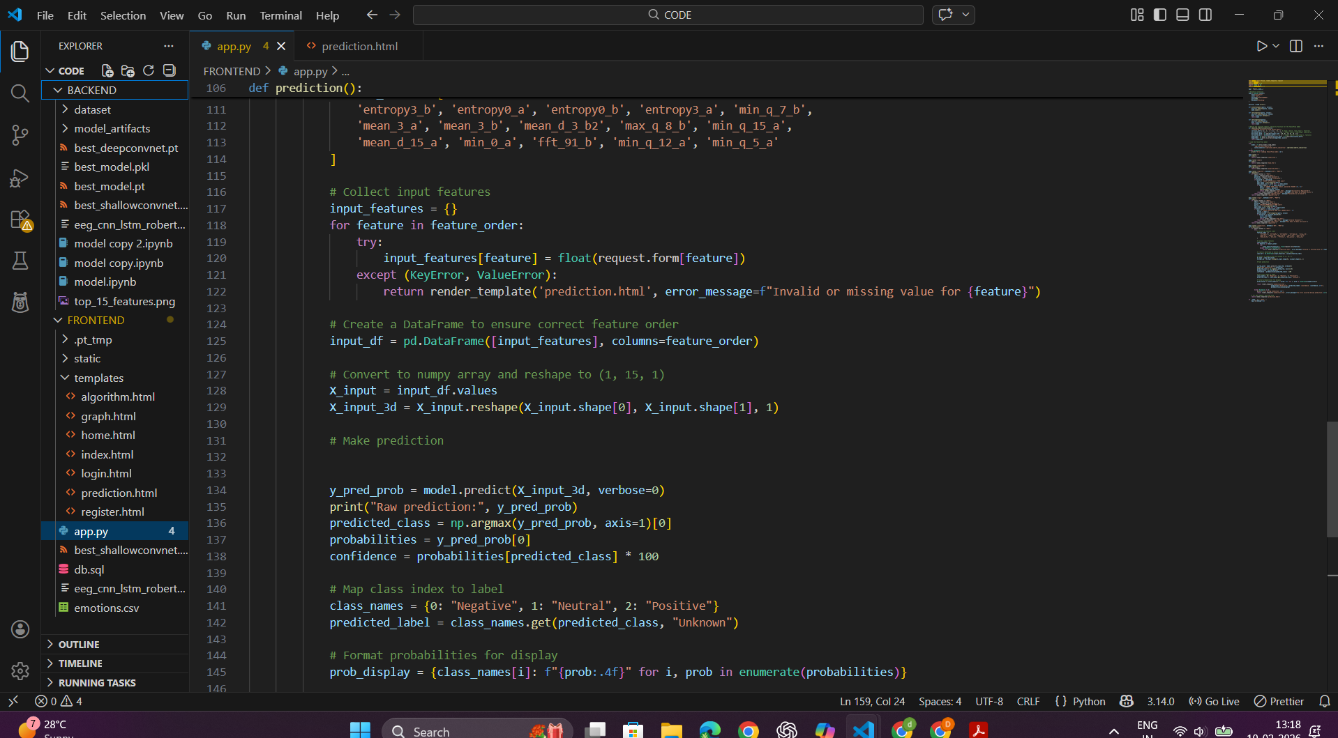
PROJECT IMPLEMENTATION

Slide 25
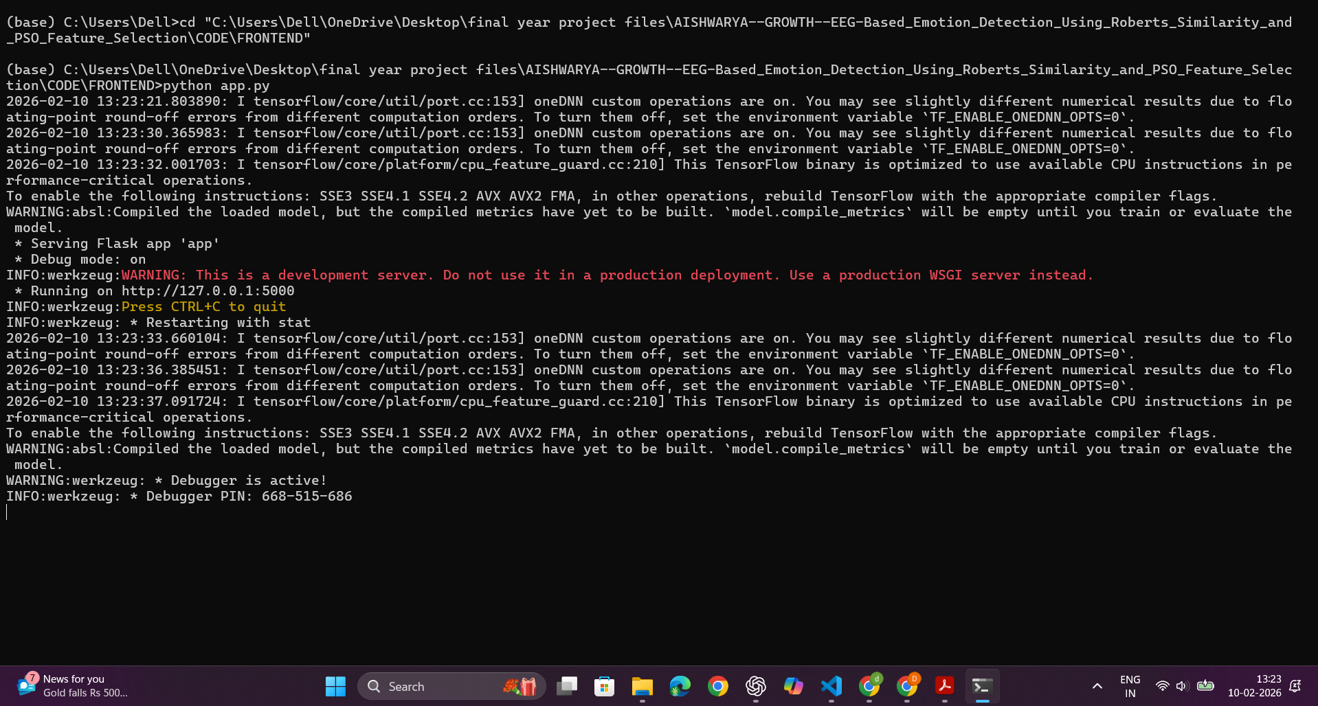
PROJECT IMPLEMENTATION
Code Running on: http://127.0.0.1:5000

Slide 26

OUTPUT SCREENS
Landing Homepage:
This landing page is for an EEG-based emotion detection system that uses Roberts Similarity and PSO Feature Selection to analyze brain signals. The site's clean design highlights the platform's ability to combine neuroscience with machine learning for accurate emotion recognition.

Slide 27
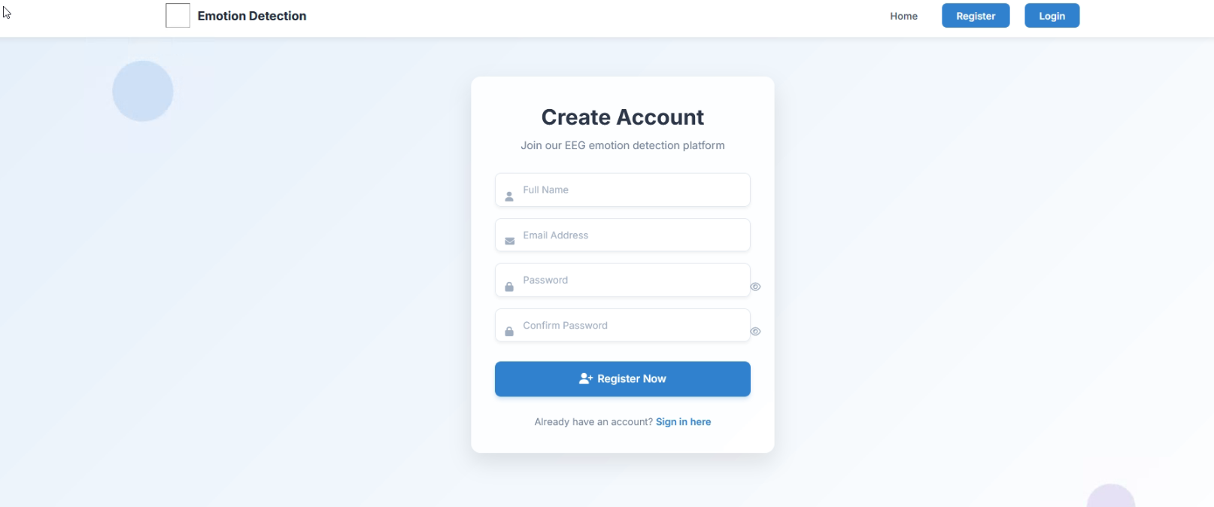
OUTPUT SCREENS
Register Page: This page allows new users to sign up by entering personal details like name, age, email, and password. The form ensures secure and authenticated access to the prediction system.

Slide 28
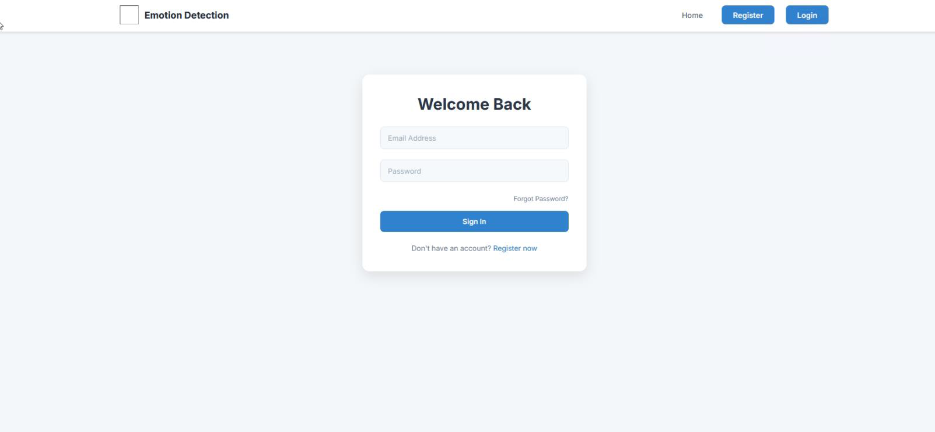
OUTPUT SCREENS
Login Page: Registered users can securely log into the system using their email and password. This page validates user credentials before granting access to the prediction features.

Slide 29
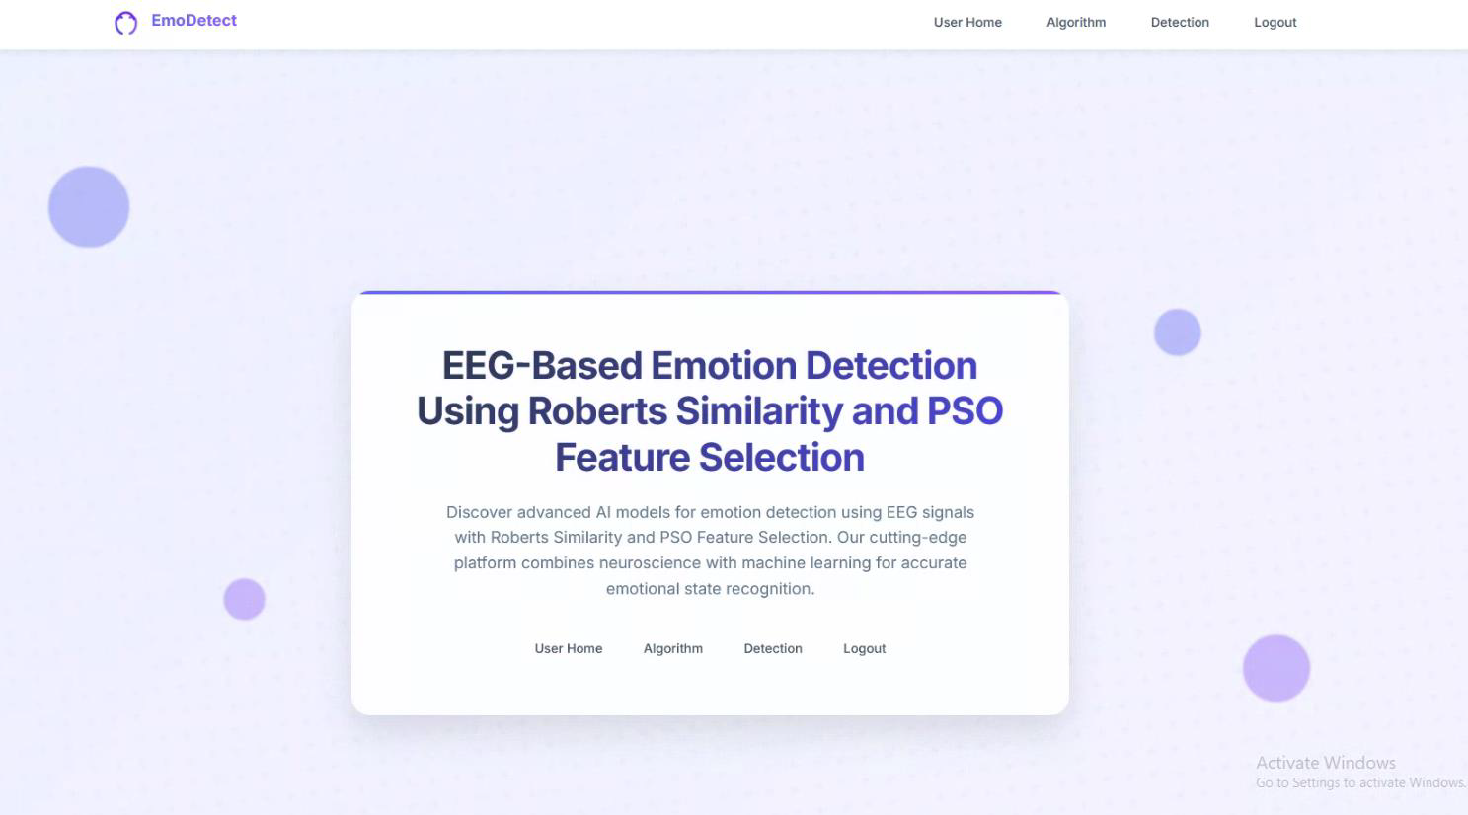
OUTPUT SCREENS
Dashboard: Shows the logged-in Emotion Detect interface with user options like Home, Algorithm, Detection, and Logout. It confirms successful login and displays the system features for EEG-based emotion detection.

Slide 30
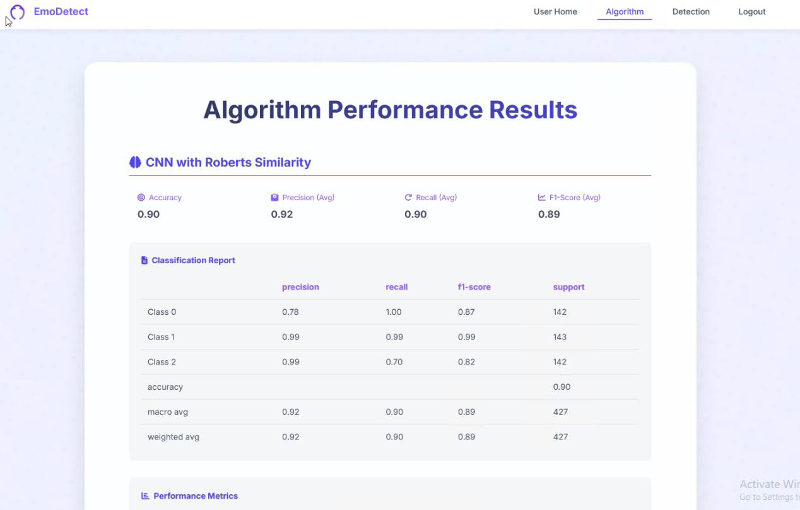
OUTPUT SCREENS
Algorithm: Displays the performance evaluation of the EmoDetect emotion detection model. It shows a classification report with precision, recall, and F1-score for each emotion category.

Slide 31
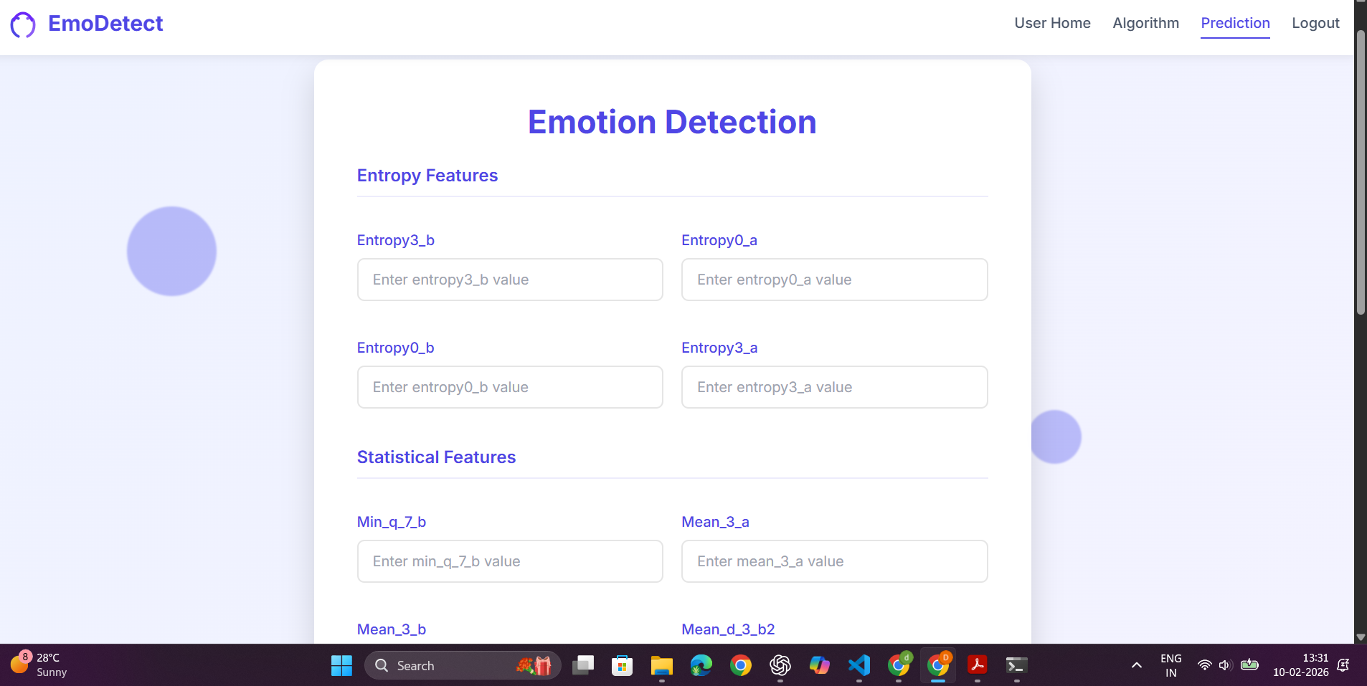
OUTPUT SCREENS
Prediction Page: Allows users to enter EEG feature values (Entropy, Statistical, and FFT) to analyze and detect emotions. The system processes these inputs and displays the predicted emotion along with a confidence percentage.

Slide 32
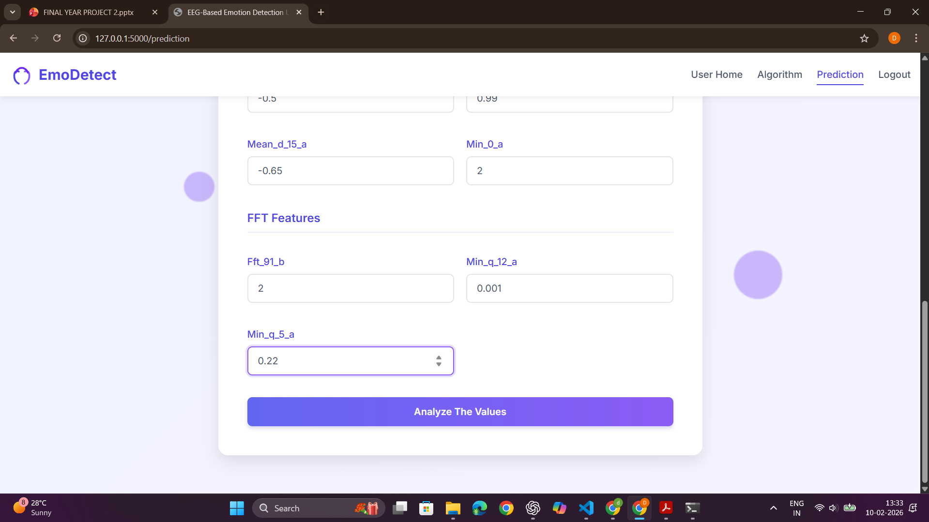
OUTPUT SCREENS

Slide 33
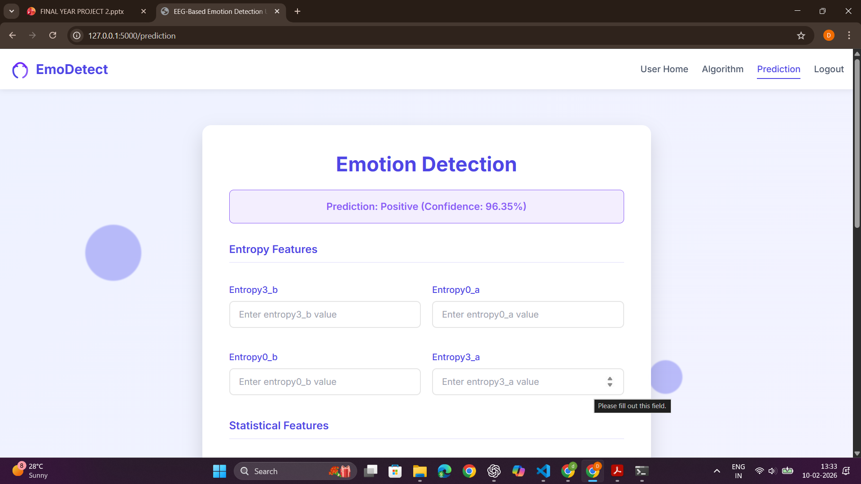
OUTPUT SCREENS

Slide 34
LITERATURE SURVEY
Sr No | Title | Author(s) | Year | Outcome
1. | Lightweight Building of an Electroencephalogram-Based Emotion Detection System | Al-Nafjan, A., Alharthi, K., & Kurdi, H. | 2020 | 84.62% accuracy with 60 EEG samples
2. | EEG-Based Emotion Recognition by Exploiting Fused Network Entropy Measures of Complex Networks across Subjects | Yao, L., Wang, M., Lu, Y., Li, H., & Zhang, X. Akter, S., Prodhan, R. | 2021 | 87.26% accuracy on SEED dataset
3. | M1M2: Deep-Learning-Based Real-Time Emotion Recognition from Neural Activity | A., Pias, T. S., Eisenberg, D., & Fernandez, J. F. | 2022 | 99.22% accuracy with 2s EEG data
4. | EEG Emotion Recognition Using Fusion Model of Graph Convolutional Neural Networks and LSTM | Yin, Y., Zheng, X., Hu, B., Zhang, Y., & Cui, X. | 2021 | Enhanced spatial-temporal classification
5. | Semi-Skipping Layered Gated Unit and Efficient Network: Hybrid Deep Feature Selection Method for Edge Computing in EEG-Based Emotion Classification | Asghar, M. A., Khan, M. J., Shahid, H., Shorfuzzaman, M., Xiong, N. N., & Mehmood, R. M. | 2021 | Improved accuracy and efficiency

Slide 35
REFERENCES
Al-Nafjan, A., Alharthi, K., & Kurdi, H. (2020). Lightweight Building of an Electroencephalogram-Based Emotion Detection System. Brain Sciences, 10(11), 781. MDPI.
Yao, L., Wang, M., Lu, Y., Li, H., & Zhang, X. (2021). EEG-Based Emotion Recognition by Exploiting Fused Network Entropy Measures of Complex Networks across Subjects. Entropy, 23(8), 984. MDPI+1.
Akter, S., Prodhan, R. A., Pias, T. S., Eisenberg, D., & Fernandez, J. F. (2022). M1M2: Deep-Learning-Based Real-Time Emotion Recognition from Neural Activity. Sensors, 22(21), 8467. MDPI.
Yin, Y., Zheng, X., Hu, B., Zhang, Y., & Cui, X. (2021). EEG Emotion Recognition Using Fusion Model of Graph Convolutional Neural Networks and LSTM. Applied Soft Computing, 100, 106954. MDPI.
Asghar, M. A., Khan, M. J., Shahid, H., Shorfuzzaman, M., Xiong, N. N., & Mehmood, R. M. (2021). Semi-Skipping Layered Gated Unit and Efficient Network: Hybrid Deep Feature Selection Method for Edge Computing in EEG-Based Emotion Classification. IEEE Access, 9, 13378–13389.
Cheng, J., Chen, M., Li, C., Liu, Y., Song, R., Liu, A., & Chen, X. (2021). Emotion Recognition from Multi-Channel EEG via Deep Forest. IEEE Journal of Biomedical and Health Informatics, 25, 453–464.
Zhang, X., Du, T., & Zhang, Z. (2021). EEG Emotion Recognition Based on Channel Attention for E-Healthcare Applications. In Transactions on Petri Nets and Other Models of Concurrency X (pp. 159–169). Springer.
Liu, Y., & Fu, Y. (2021). Emotion Recognition by Deeply Learned Multi-Channel Textual and EEG Features. Future Generation Computer Systems, 119, 1–6. MDPI.

Slide 36
Thank You

